Slide 1
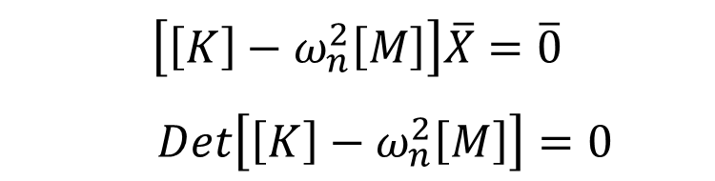
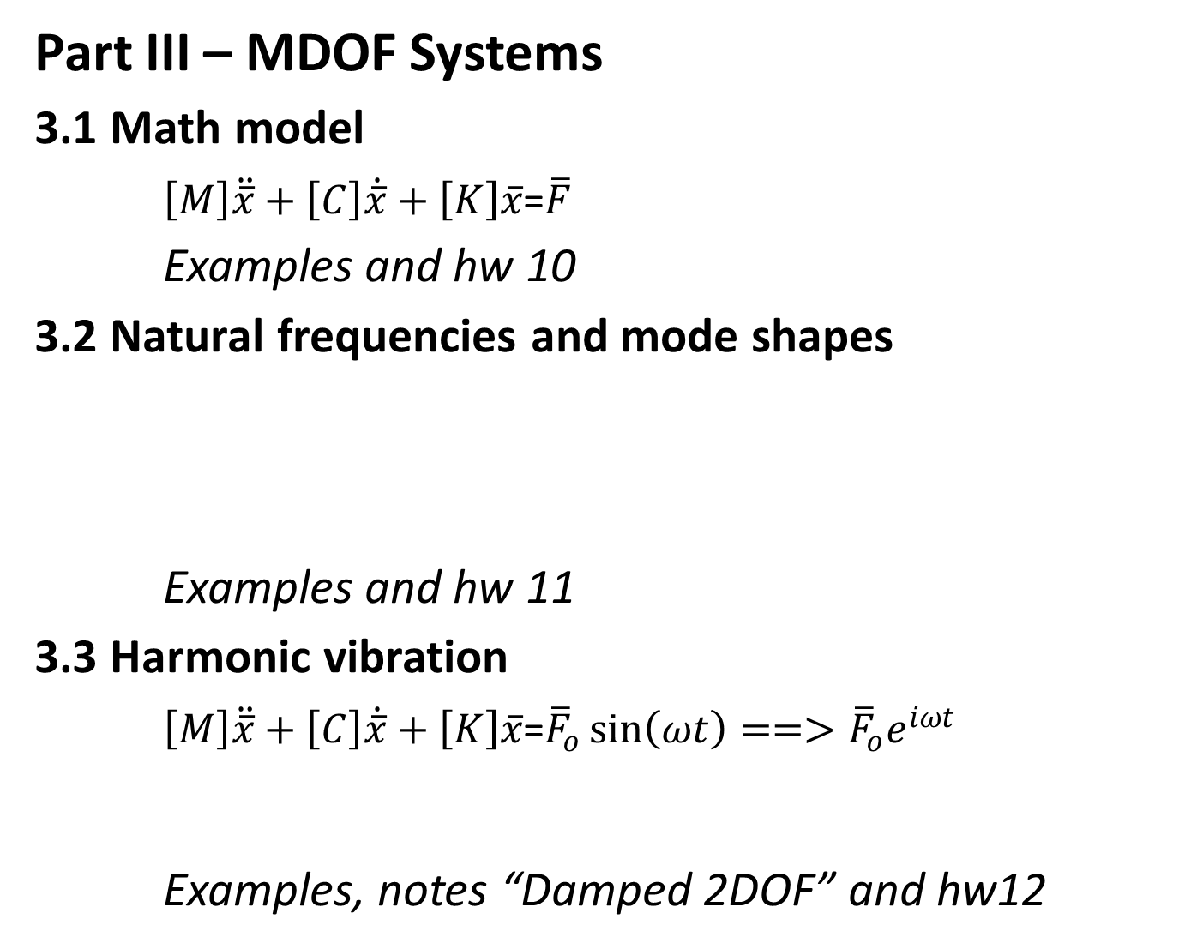
Part III – MDOF Systems
3.1 Math model
$\left[M\right]\ddot{\overline{x}}+\left[C\right]\dot{\overline{x}}+\left[K\right]\overline{x}$=$\overline{F}$
Examples and hw 10
3.2 Natural frequencies and mode shapes
Examples and hw 11
3.3 Harmonic vibration
$\left[M\right]\ddot{\overline{x}}+\left[C\right]\dot{\overline{x}}+\left[K\right]\overline{x}$=${\overline{F}}_{o}\sin\left(ωt\right)==>{\overline{F}}_{o}e^{iωt}$
Examples, notes “Damped 2DOF” and hw12
$$\left[\left[K\right]−ω_{n}^{2}\left[M\right]\right]\overline{X}=\overline{0}$$
$Det\left[\left[K\right]−ω_{n}^{2}\left[M\right]\right]=0$

Slide 2
Part IV – Vibration Reduction
4.1 Vibration isolation
Notes, examples and hw13
4.2 Vibration absorption
Notes, examples and hw 13
4.3 Balancing of machines
Notes and example

