Slide 1
Video Measurement of Golf Green Putting Speed Using a Cellphone
Joe Sommer, Tim Lulis, John Kaminski
Mechanical Engineering and Plant Science
The Pennsylvania State University
experimental
kinematics
lab

Slide 2
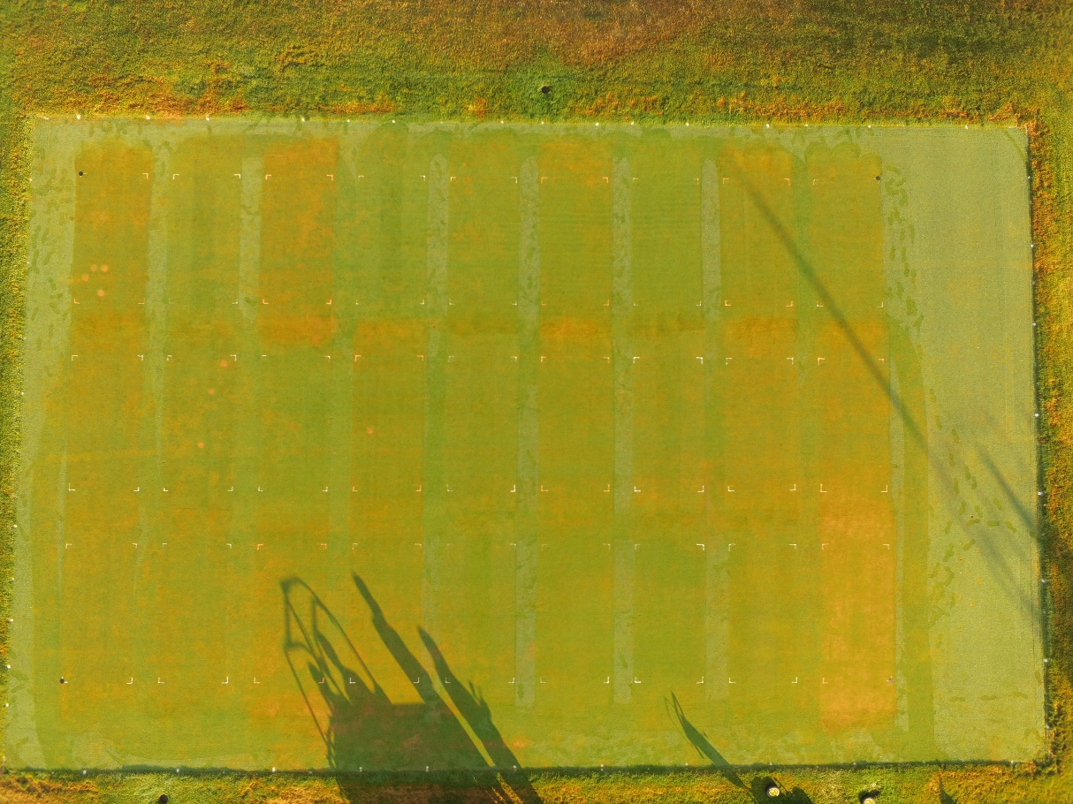
Weekend Project ?
27 Stimpmeter readings per day
Cellphone video
White ball on green background
Deceleration
s = v² / 2 a
experimental
kinematics
lab

Slide 3
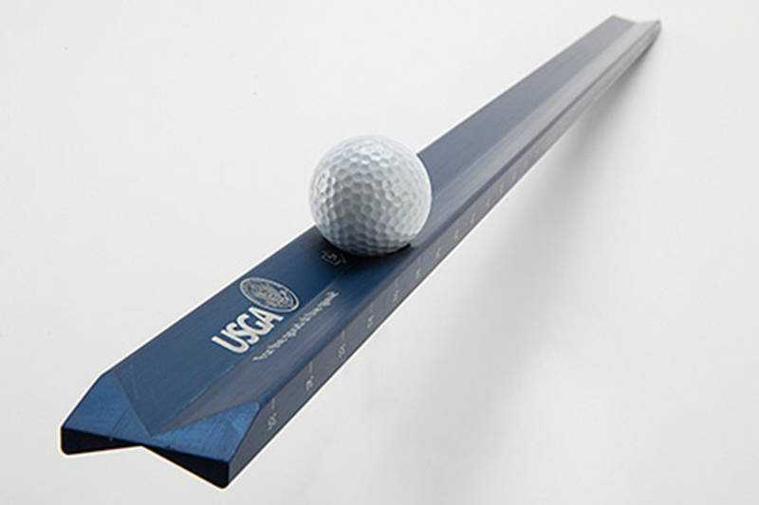
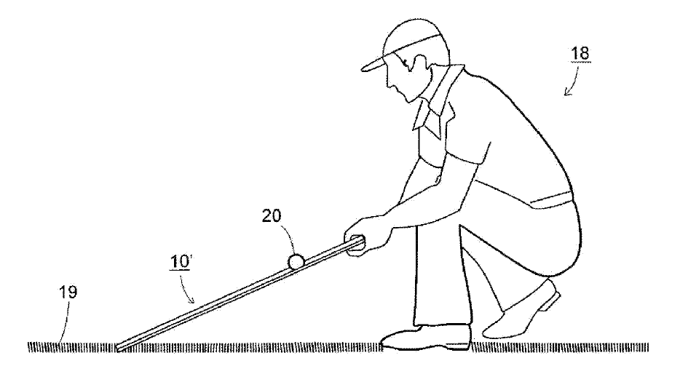
Stimpmeter
Edward Stimpson 1935
USGA patent 2015 ($120)
Release ball at 20 degree angle
Measure ball roll distance (BRD) in feet
Consistent v_{LAUNCH}
  1X notch, 6 ft/sec
  2X notch, 4.243 ft/sec
experimental
kinematics
lab

Slide 4
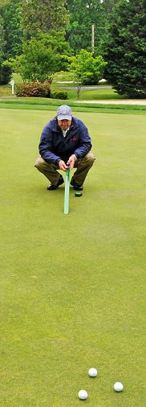
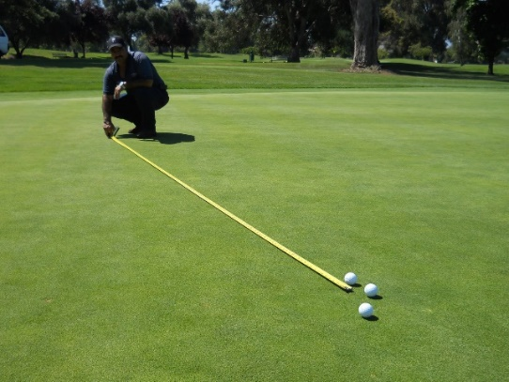
Stimpmeter Reading - 6 rolls
Mark start location, roll 3 balls
  Not more than 8 inches apart
Mark first average location
Roll 3 balls in opposite direction
Mark second average location
Measure from start to first average
Measure from first to second average
Use mean of two distances
  Within 18 inches
experimental
kinematics
lab

Slide 5
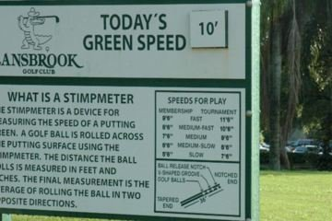
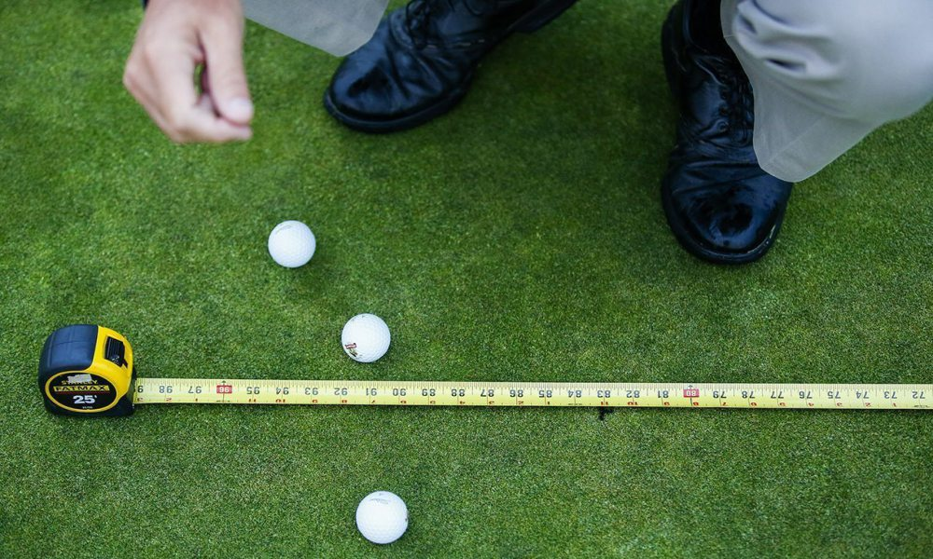
Methods
A4 bentgrass, flat
Trial 0
  1X notch, 100 BRD
Trial 1
  2X notch, 36 tests, 216 BRD
  Develop computational model
Trial 2
  2X notch, 37 tests, 222 BRD
  Validate model
experimental
kinematics
lab

Slide 6
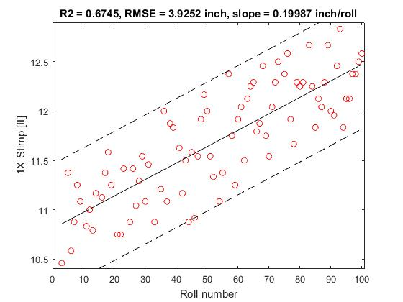
Trial 0
1X notch, 100 rolls, same location, no video
RMSE 3.93 inch
0.2 inch/roll
plastic
deformation
Rana, Askew
(2017)
experimental
kinematics
lab

Slide 7
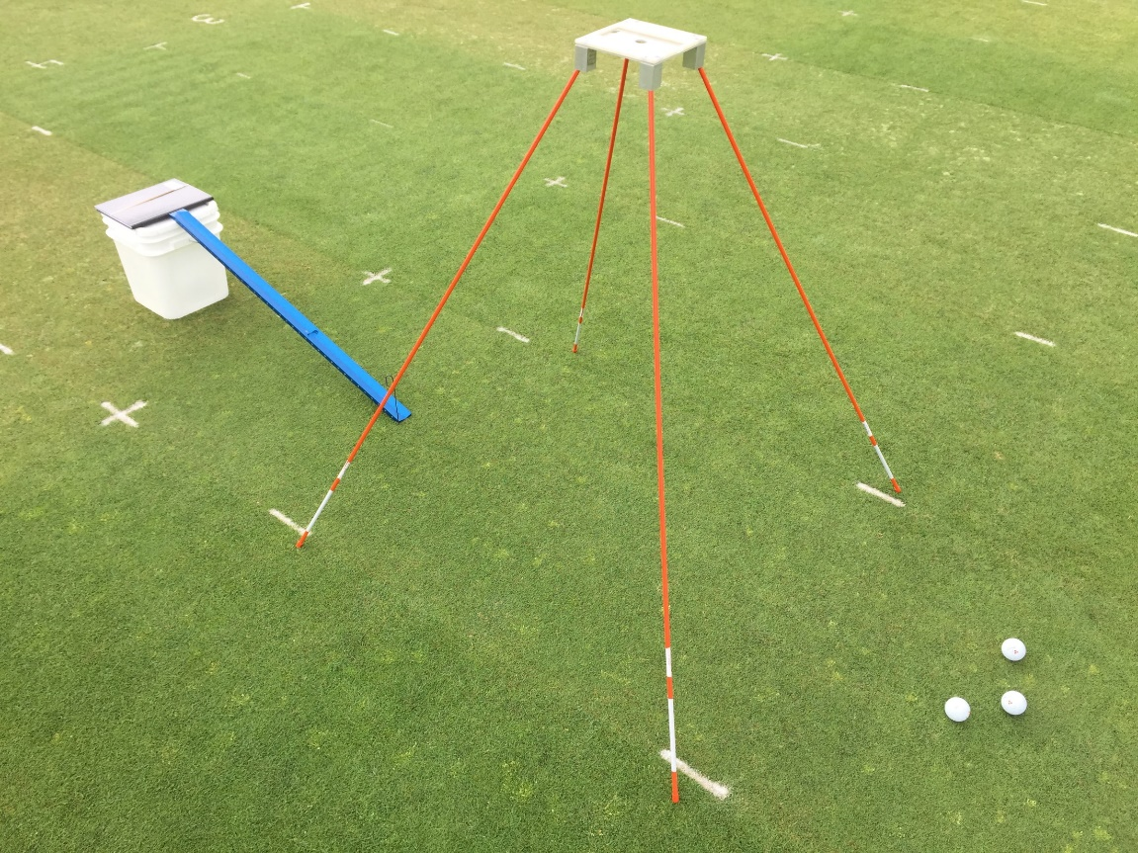
Video Photogrammetry
iPhone 6 back camera
  30 fps video, 1920x1080 pixels
42 inches above turf, level
  40 inch FOV
  48 pix/inch
Random locations
  Start/middle/end
  Stimpmeter not visible
  OK to stop in FOV
experimental
kinematics
lab

Slide 8
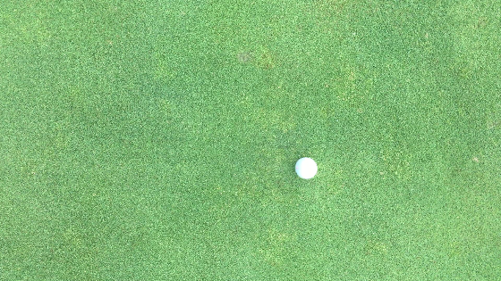
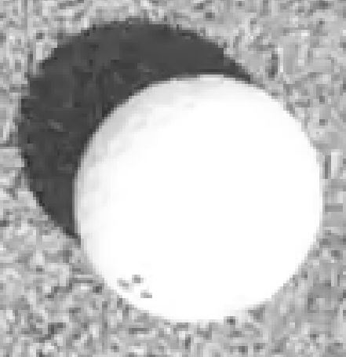

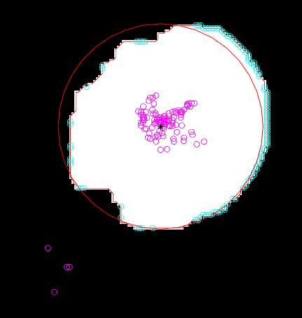
Video Analysis
Personal computer using MATLAB
Binarize
  Mean intensity + two stdev
  Morphological open/close 10x10
Blob analysis
  Centroid location in pixels
  Area in pixels (affected by shadow)
Boundary analysis
  Circle fit
  Ball diameter in pixels
experimental
kinematics
lab

Slide 9
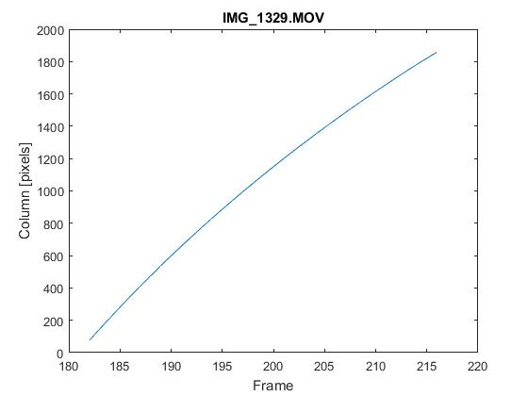
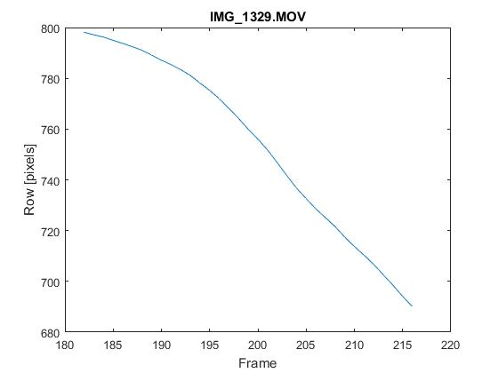
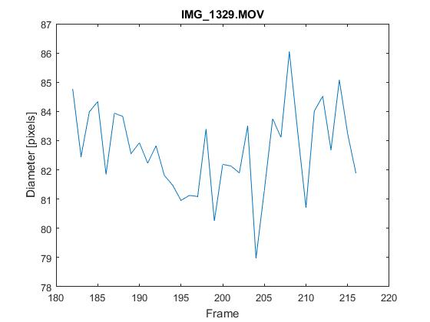
Video Results
experimental
kinematics
lab

Slide 10
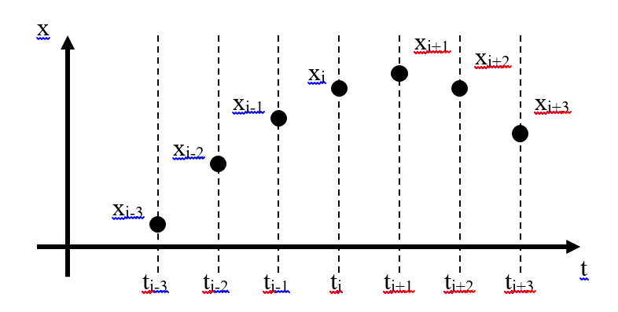
Kinematics
Pixels per inch
  Camera calibration for initial analysis
  Mean ball diameter in pixels / 1.68 inch
X-Y location in inches versus time
  Blob centroid, not center for circle fit
Savitsky-Golay 7-point floating cubic interpolant
  Position, velocity and acceleration
experimental
kinematics
lab

Slide 11
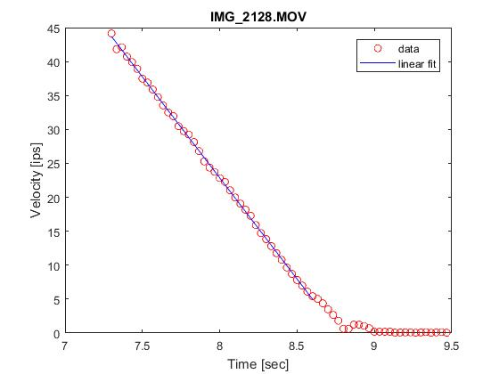
Linear Velocity - Model
Pure rolling, constant deceleration
v = p₁ t + p₂ a = -p1
s_{LIN_VEL} = (v_{LAUNCH})² / 2 a
Typical values for 1X notch
  v_{LAUNCH} = 6 ft/sec, a = 1.5 ft/sec², s_{LIN_VEL} = 12 ft
accel is function of vel
  Hubbard, Alaways (1999)
  Brearly, deMestre (2004)
experimental
kinematics
lab

Slide 12
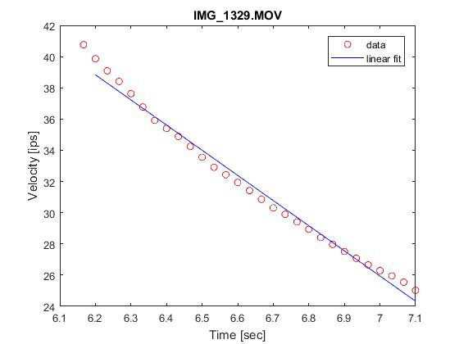
Linear Velocity - Results
fit velocity as linear function of time
slope is decel
higher decel higher vel
lower slope
lower vel
experimental
kinematics
lab

Slide 13
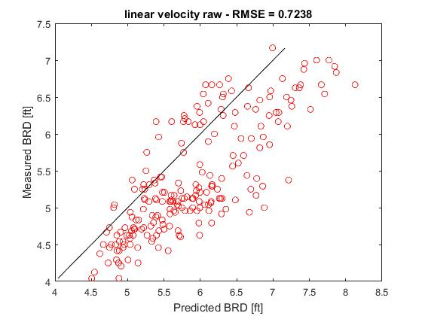
Linear Velocity - Predictions
fit velocity as linear function of time
Trial 1
2X notch
30 fps
N = 216
experimental
kinematics
lab

Slide 14
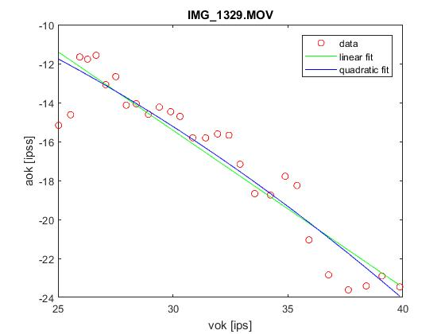
Alternate Models
Quadratic velocity
  v = p₁ t² + p₂ t + p₃
Cubic position
  x = p₁ t³ + p₂ t² + p₃ t + p₄
Linear drag ODE
  a = p₁ v + p₂
Quadratic drag ODE
  a = p₁ v² + p₂
experimental
kinematics
lab

Slide 15
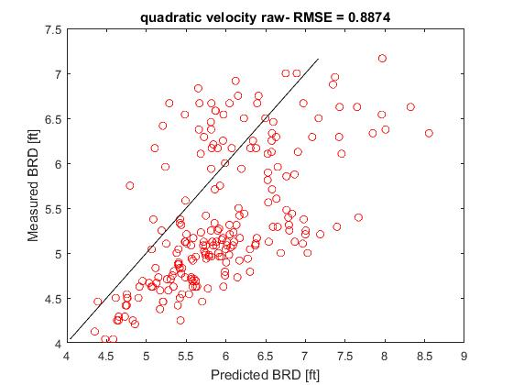
Quadratic Velocity - Predictions
fit velocity as quadratic function of time
Trial 1
2X notch
30 fps
N = 216
experimental
kinematics
lab

Slide 16
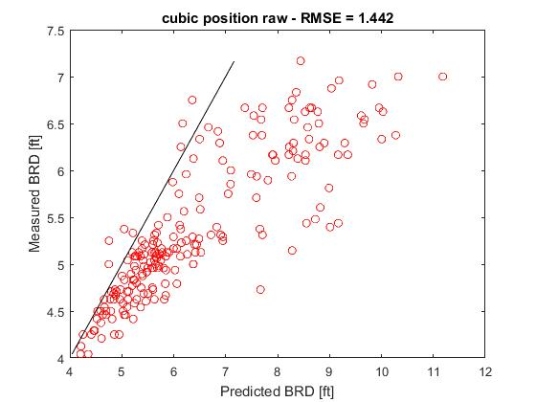
Cubic Position - Predictions
fit position as cubic function of time
Trial 1
2X notch
30 fps
N = 216
experimental
kinematics
lab

Slide 17
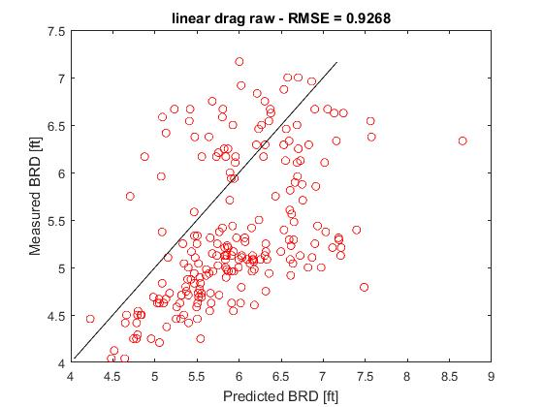
Linear Drag ODE - Predictions
fit acceleration as linear function of velocity
Trial 1
2X notch
30 fps
N = 216
experimental
kinematics
lab

Slide 18
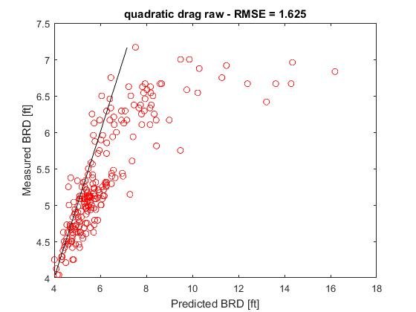
Quadratic Drag ODE - Predictions
fit acceleration as quadratic function of velocity
Trial 1
2X notch
30 fps
N = 216
experimental
kinematics
lab

Slide 19
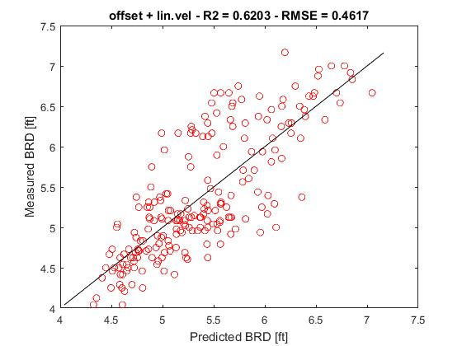
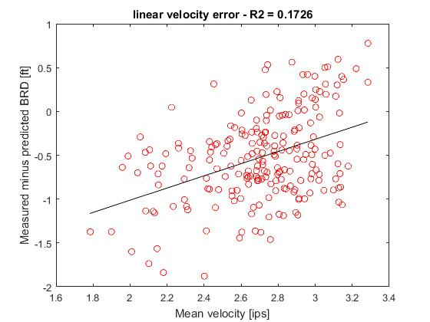
Correlation Model
Residuals correlated to v_{MEAN} during video
BRD = C₁ + C₂ s_{LIN_VEL} + C₃ v_{MEAN} + C₄ (p₁)_{QUAD_VEL}
experimental
kinematics
lab

Slide 20
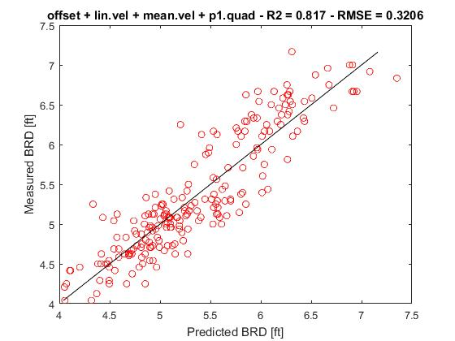
Correlation Model - Predictions
BRD = C₁ + C₂ s_{LIN_VEL} + C₃ v_{MEAN} + C₄ (p₁)_{QUAD_VEL}
s_{LIN_VEL}
(p₁)_{QUAD_VEL}
Trial 1
2X notch
30 fps
N = 216
RMSE 3.87 inch
experimental
kinematics
lab

Slide 21
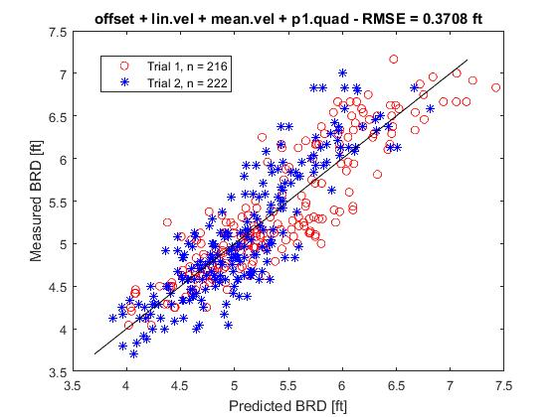
Correlation Model - Validation
Trial 1
2X notch
30 fps
N = 216
Trial 2
2X notch
30 fps
N = 222
total
RMSE 4.45 inch
experimental
kinematics
lab

Slide 22
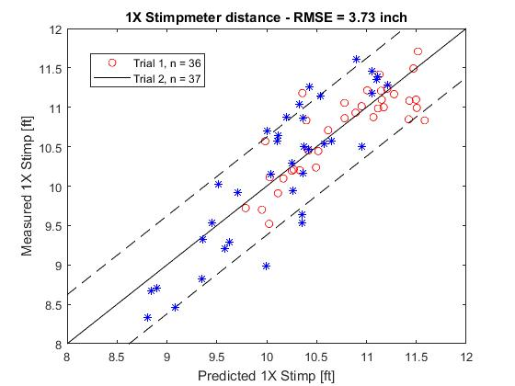
Stimpmeter - Validation
Trial 1
N = 36
Trial 2
N = 37
overall
RMSE 3.73 inch
experimental
kinematics
lab

Slide 23
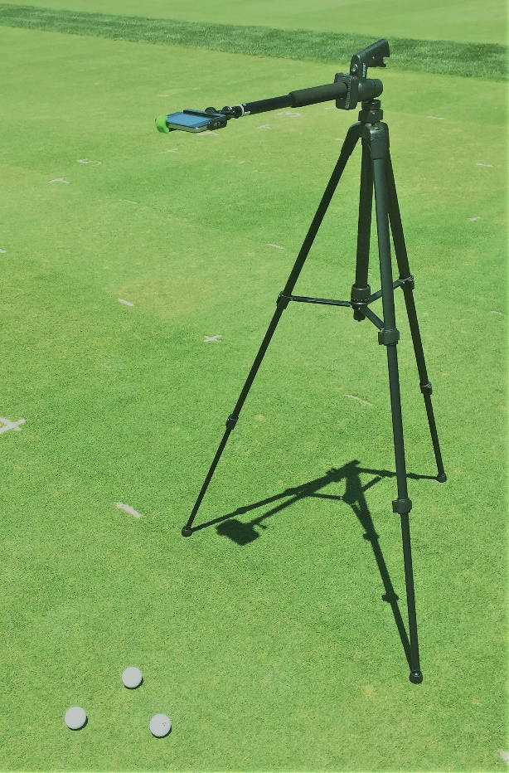
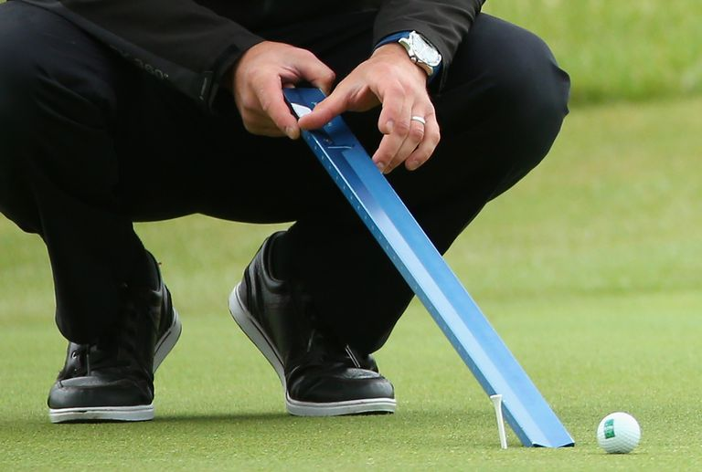
Conclusions
iPhone, iPad and Android
  Tripod mount, level
  Putt into FOV
Standard camera at 30 fps
  No special lighting
Ball diameter for photogrammetry
  Independent of camera height
95% confidence interval 7.5 inches
  Stimpmeter 3 rolls within 8 inches
experimental
kinematics
lab

Slide 24
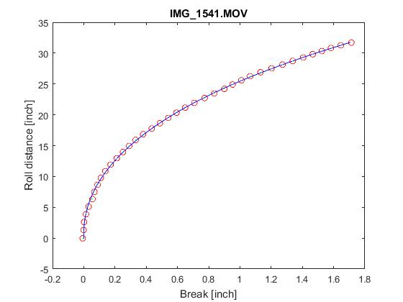
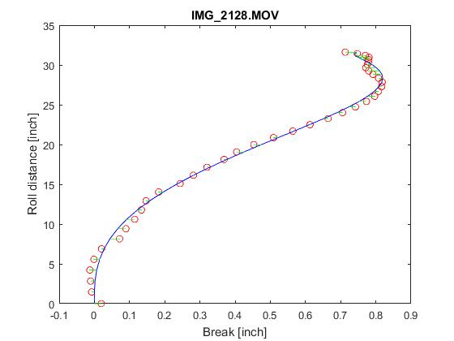
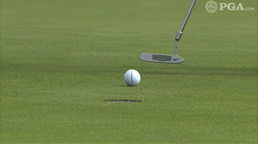
Future
Compass heading and GPS location
Measure break and consistency
experimental
kinematics
lab

Slide 25
Consistent Break
experimental
kinematics
lab

Slide 26
Stop in FOV - Velocity
experimental
kinematics
lab

Slide 27
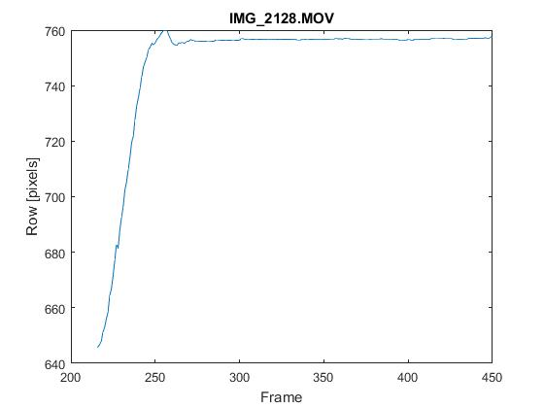
Stop in FOV - Row
experimental
kinematics
lab

Slide 28
Stop in FOV - Break
experimental
kinematics
lab

Slide 29
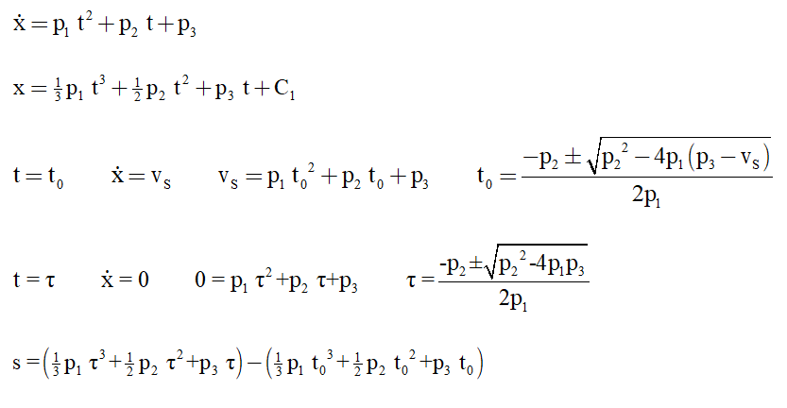
Quadratic Velocity
experimental
kinematics
lab

Slide 30
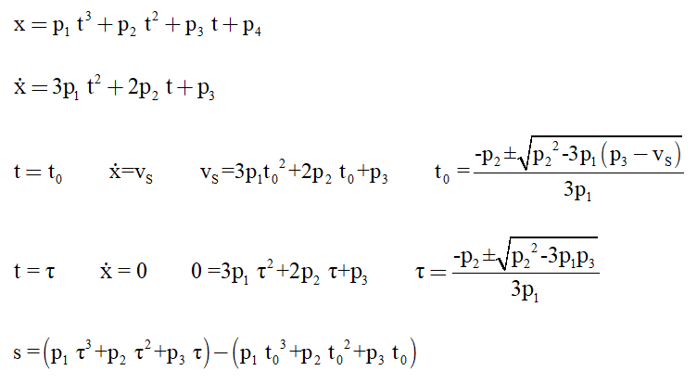
Cubic Position
experimental
kinematics
lab

Slide 31
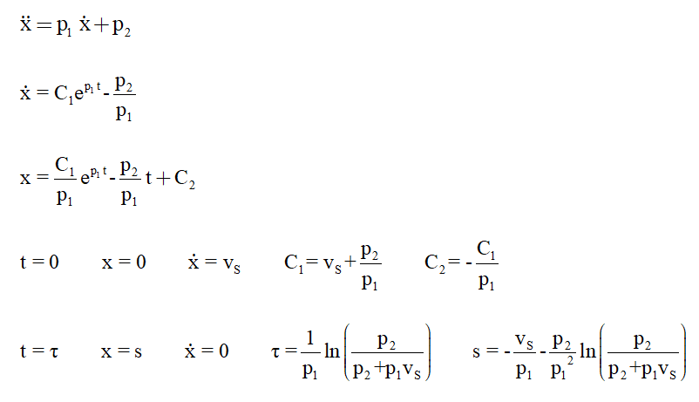
Linear Drag ODE
experimental
kinematics
lab

Slide 32
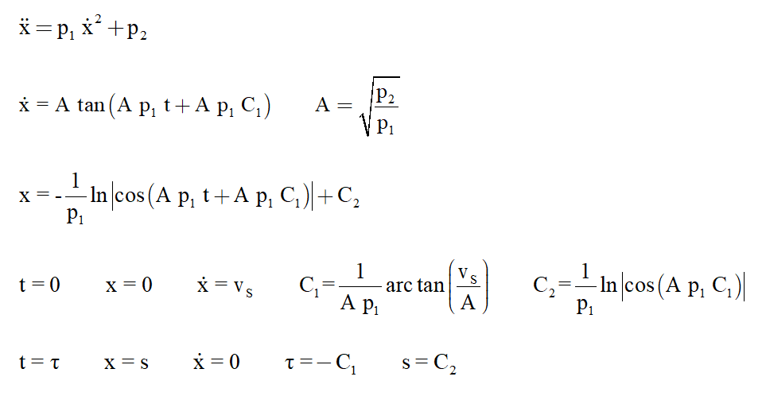
Quadratic Drag ODE
experimental
kinematics
lab

